Slide 1








Challenges of Integrating Robots with Embodied Intelligence in the Homes of Older People Living with Frailty: Towards a Smart Middleware Architecture
www.emergencerobotics.net

Slide 2













CEREI Team
Dr. Abdel-Karim
Al-Tamimi
Dr. Armaghan
Moemeni
Dr. Maher
Salem
Prof. Elvira
Perez
Mr. Joe
McLoughlin
Dr. Dave
Cameron
Mr. Waqas
Hameed
www.emergencerobotics.net

Slide 3














Why CIREI?
www.emergencerobotics.net

Slide 4










WISE-WARE
Assisted
Living
Social
Networks
Community
Services
Smart
City
Smart
UK
www.emergencerobotics.net

Slide 5





Methodology
Co-design
Domain Experts
Resources
www.emergencerobotics.net

Slide 6












Imagine
www.emergencerobotics.net

Slide 7

www.emergencerobotics.net

Slide 8

What is it?
www.emergencerobotics.net

Slide 9


You each have a "smart device"
www.emergencerobotics.net

Slide 10

Solutions
www.emergencerobotics.net

Slide 11
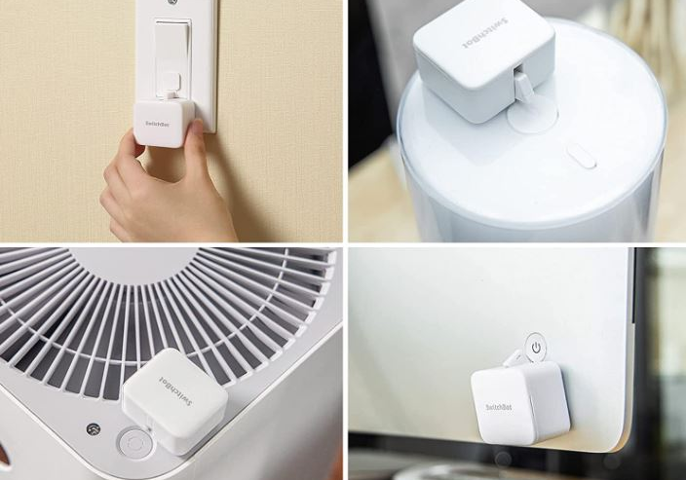
SwitchBot Bots - Switch toggler
www.emergencerobotics.net

Slide 12

SwitchBot Contact Sensor and Xiaomi Door/Window Sensor - Door/window alarm
www.emergencerobotics.net

Slide 13
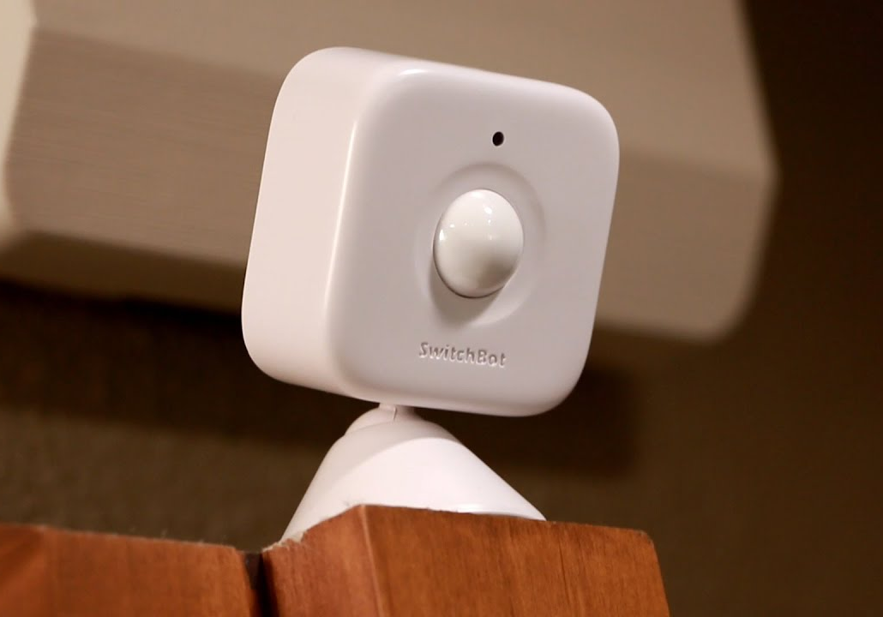
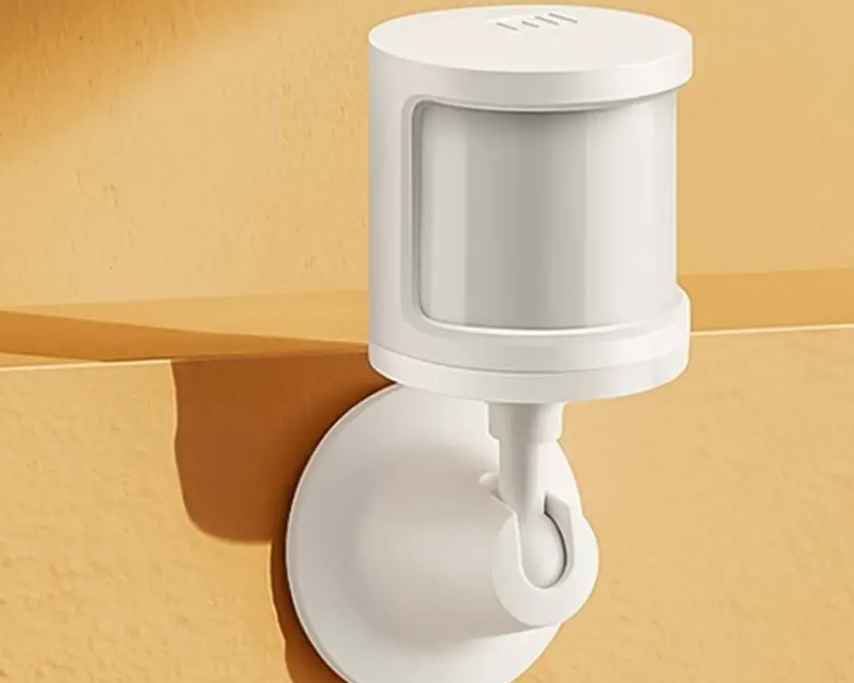
SwitchBot Motion Sensor and Xiaomi Motion Sensor
www.emergencerobotics.net

Slide 14
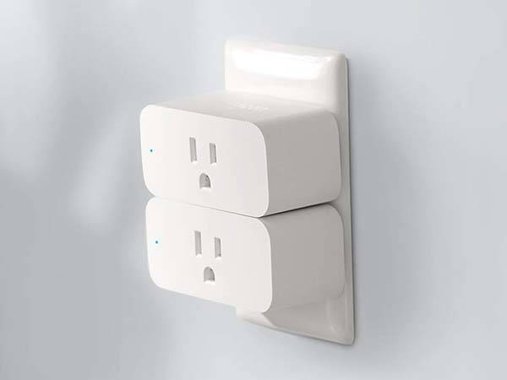
Xiaomi Smart Plug
www.emergencerobotics.net

Slide 15
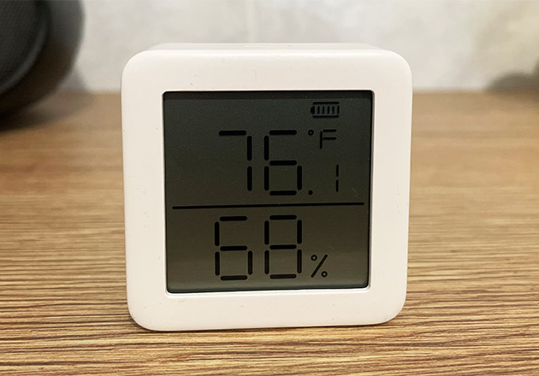
SwitchBot Meter Plus - Hygrometer
www.emergencerobotics.net

Slide 16
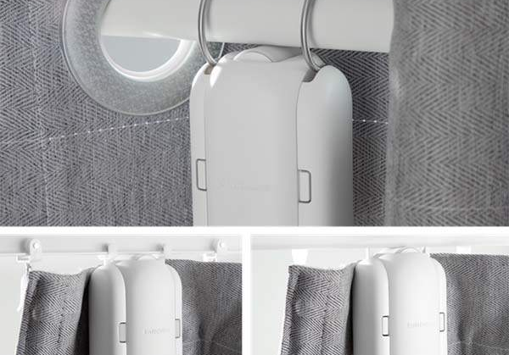
SwitchBot Curtain Rods
www.emergencerobotics.net

Slide 17
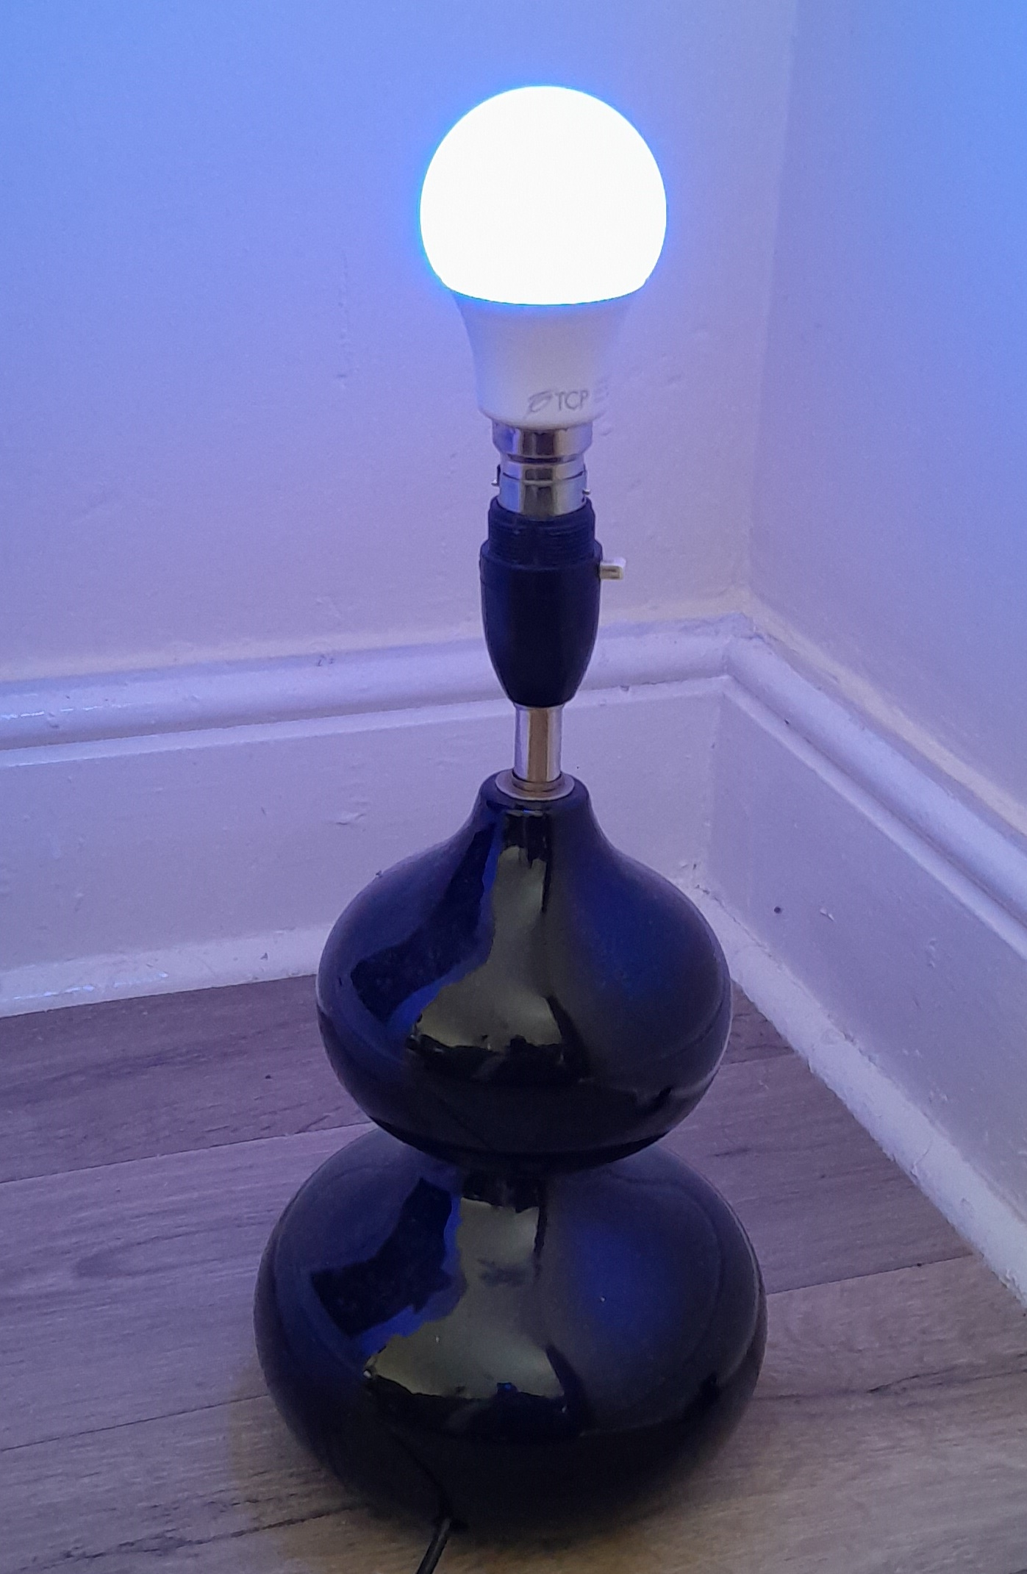
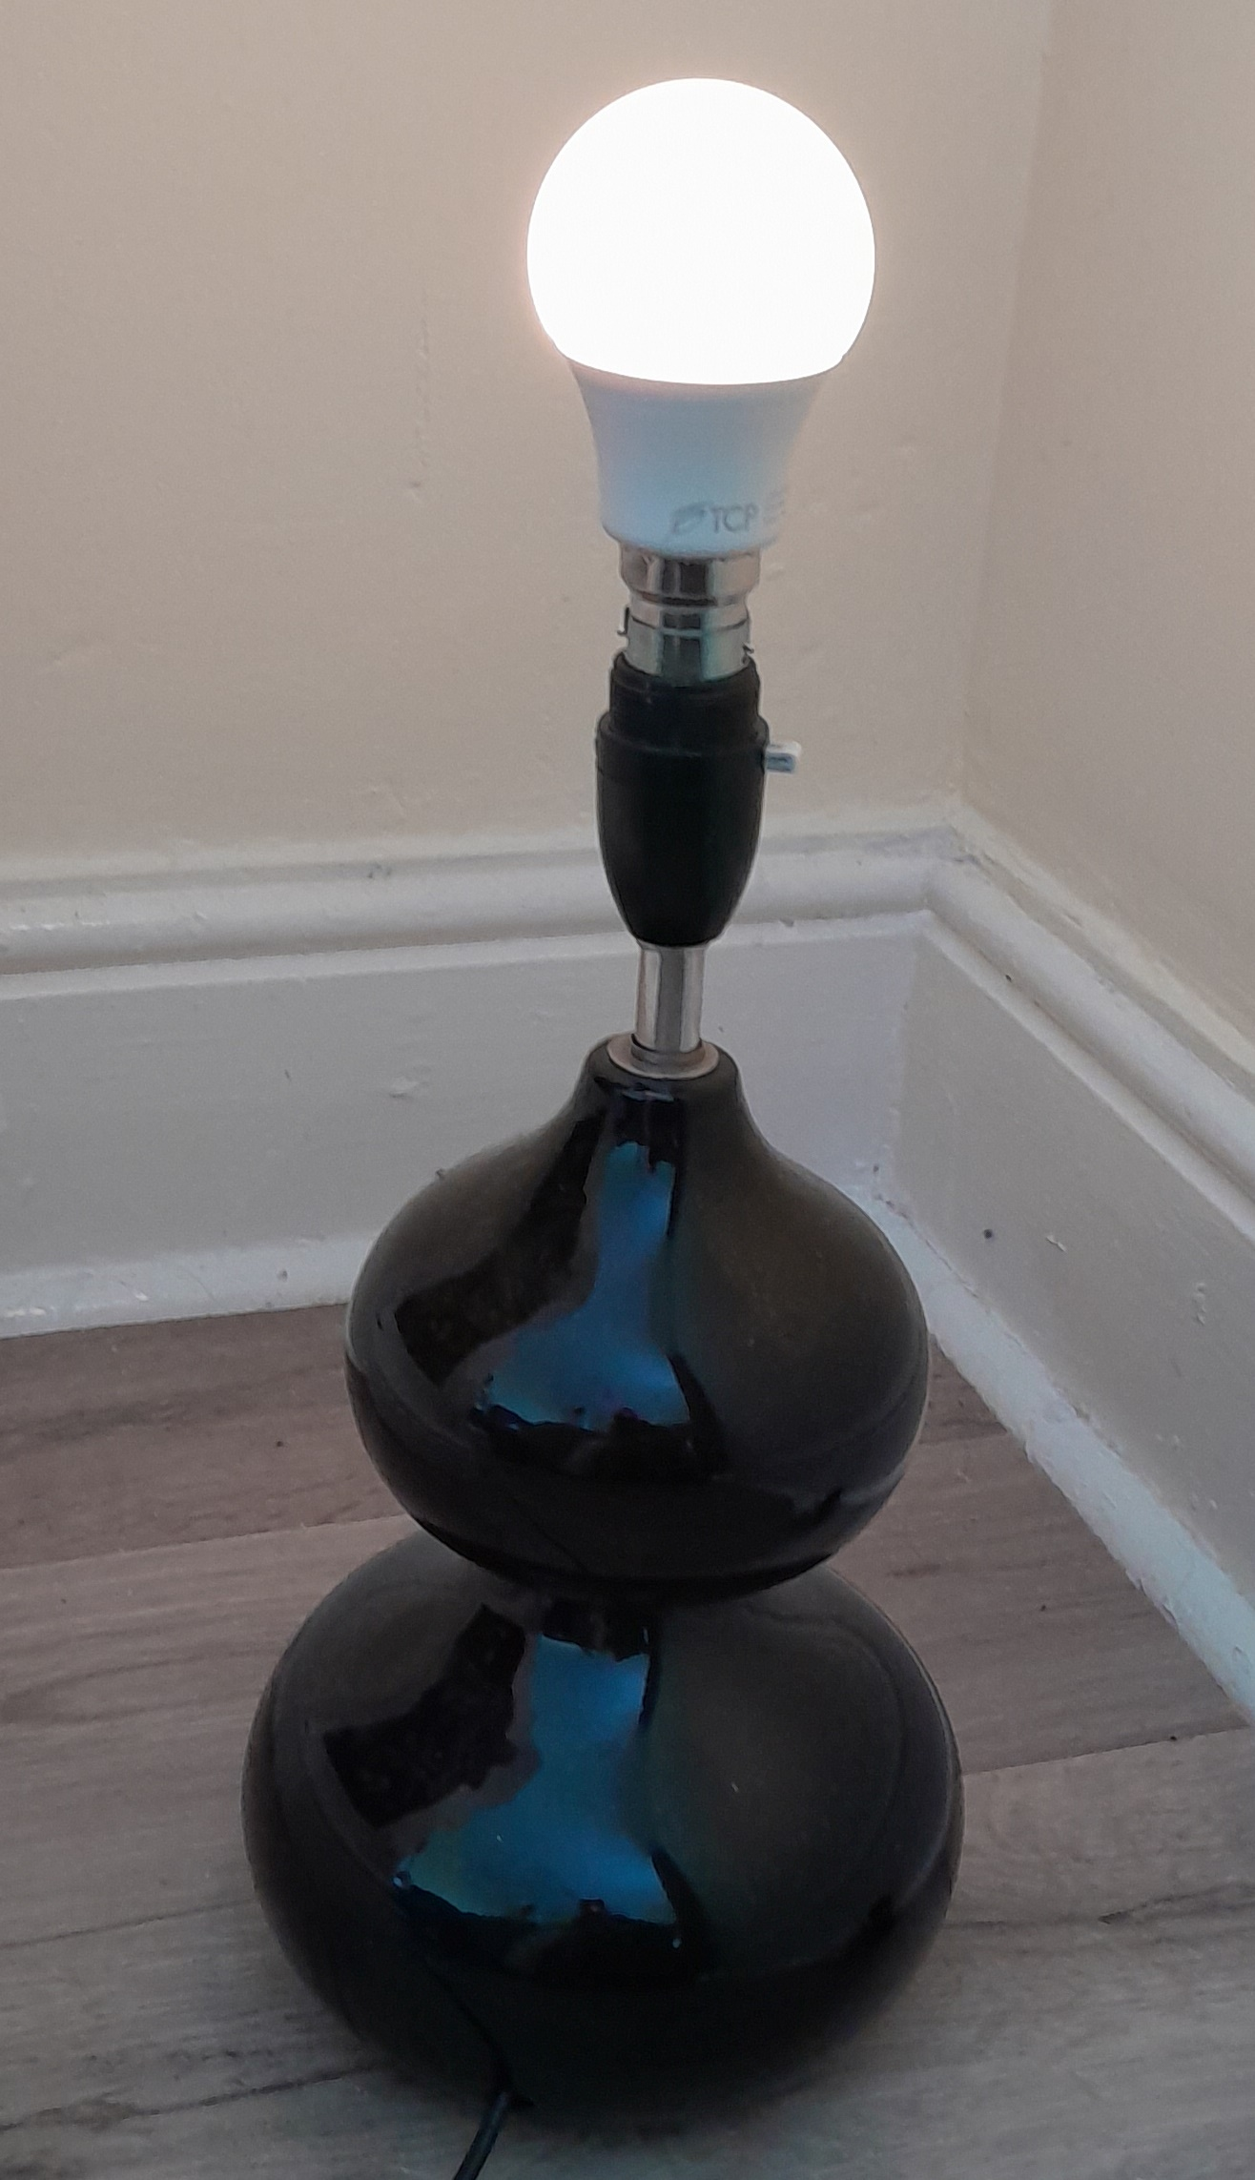
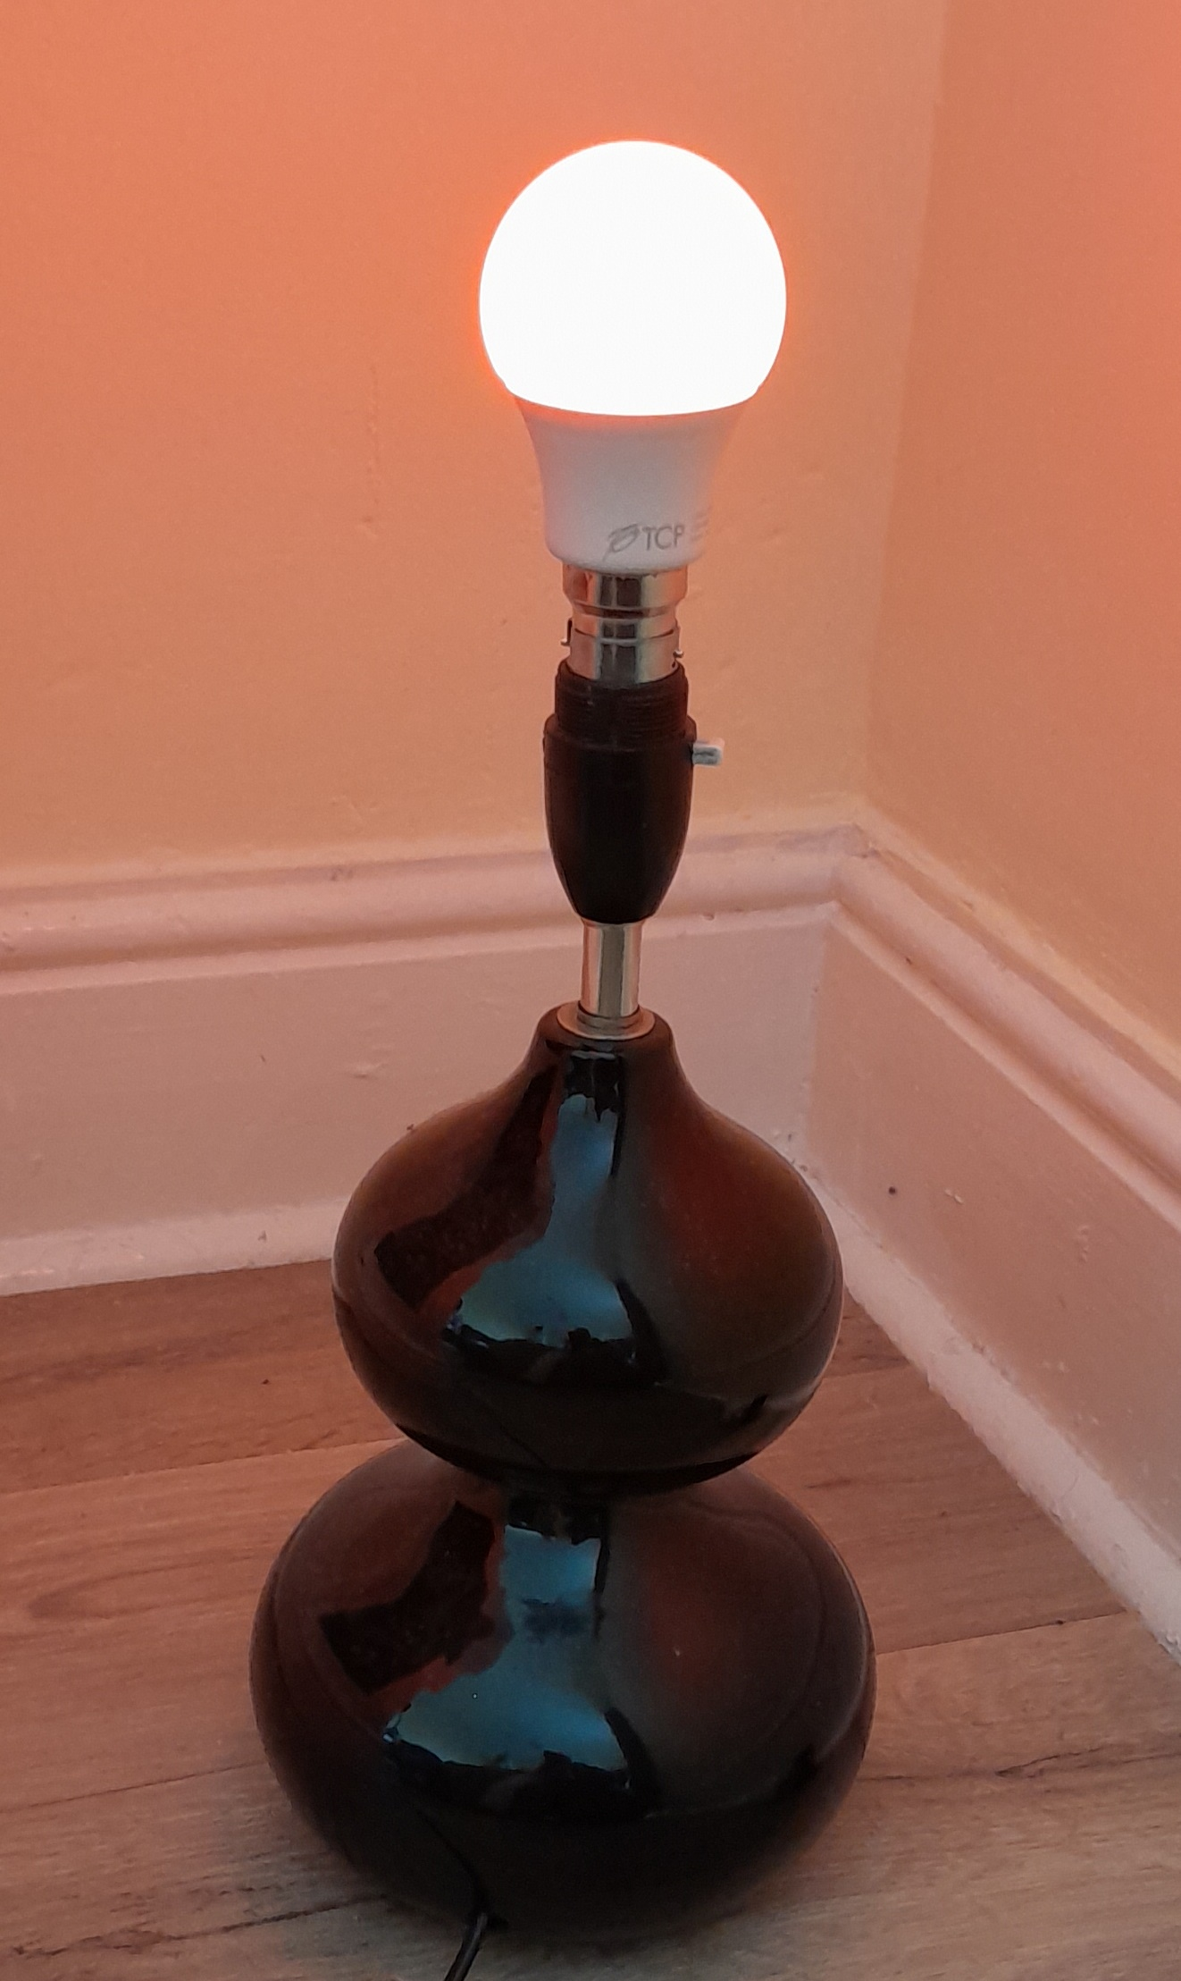
SwitchBot Colour Bulb
www.emergencerobotics.net

Slide 18



SwitchBot Remote, Xiaomi Wireless Switch and Xiaomi Cube Controller
www.emergencerobotics.net

Slide 19
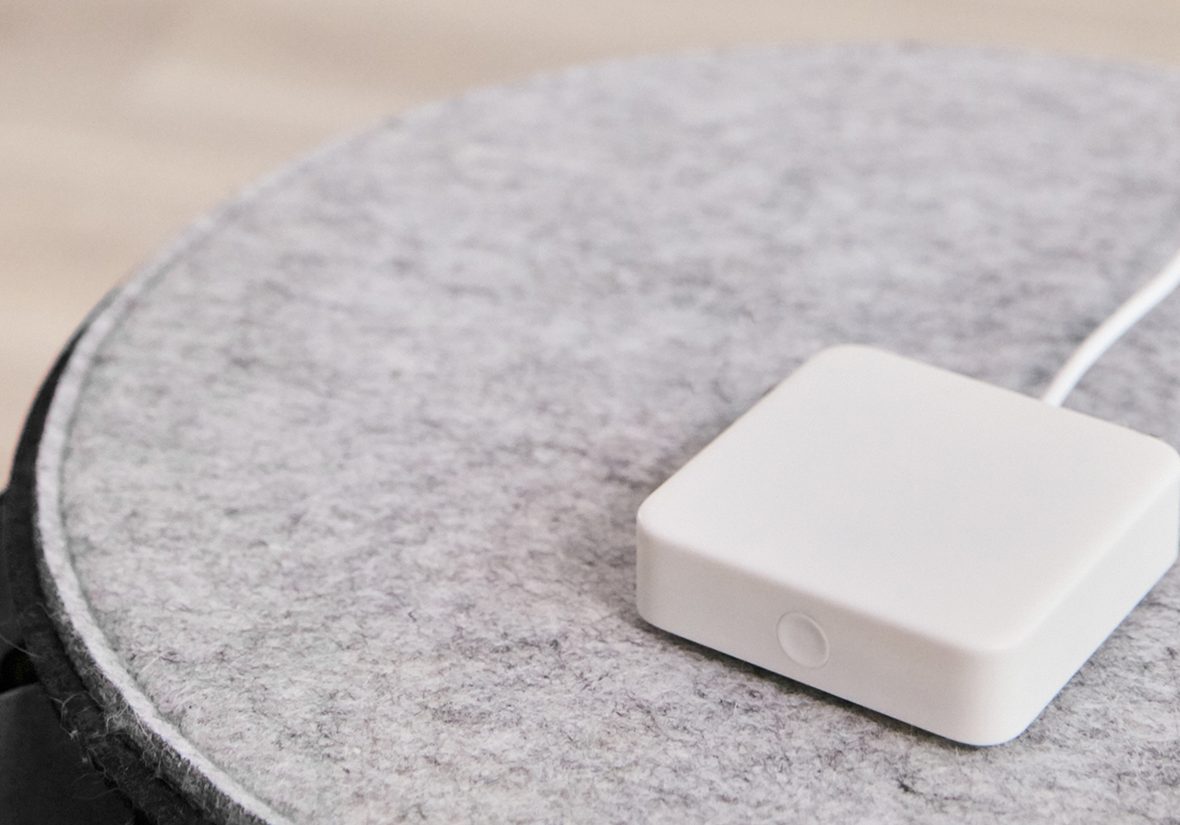
SwitchBot Hub Mini - Middleware hub
www.emergencerobotics.net

Slide 20
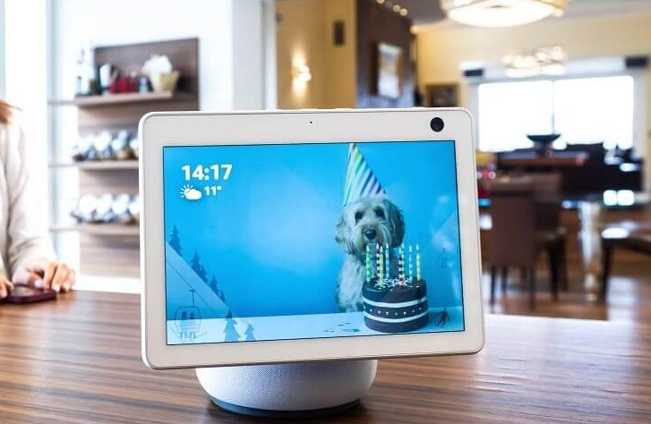
Amazon Echo Show 10 - Smart display
www.emergencerobotics.net

Slide 21
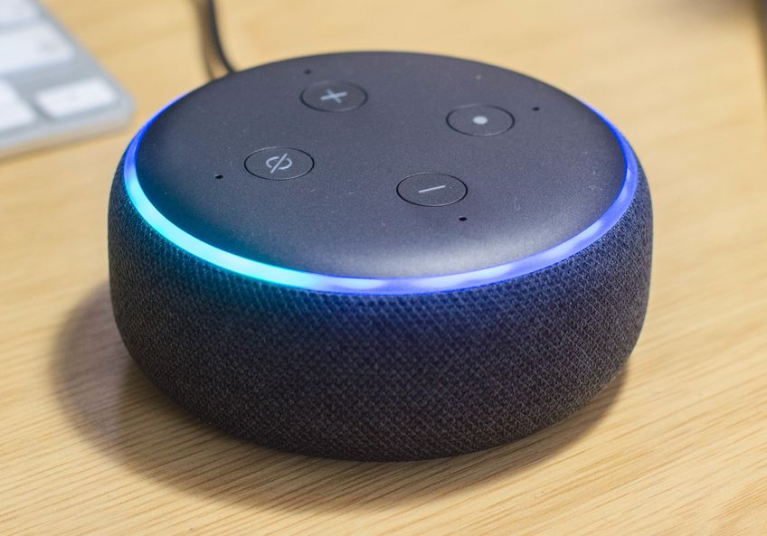
Amazon Echo Dot - Smart speaker
www.emergencerobotics.net

